Slide 1
Status of CELLAR
FFV1 & Matroska
@dericed 2018-10-25 #nttw3

Slide 2
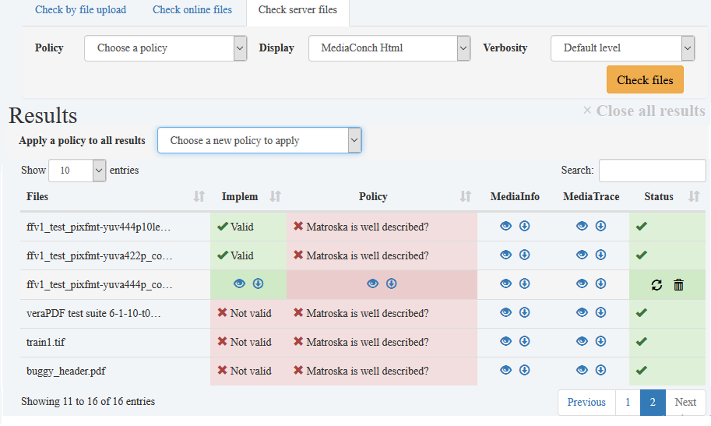
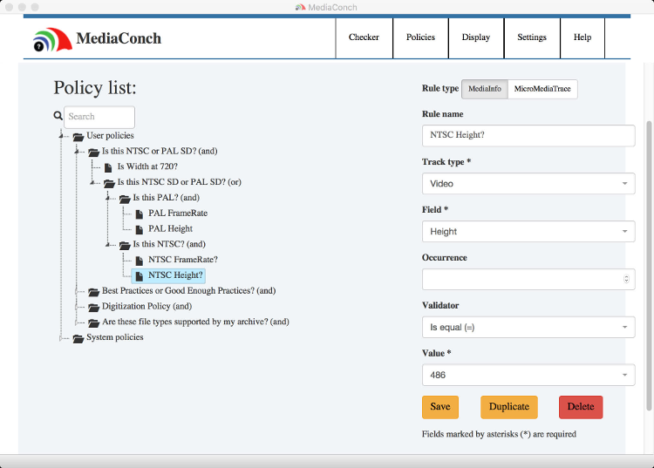

Slide 3
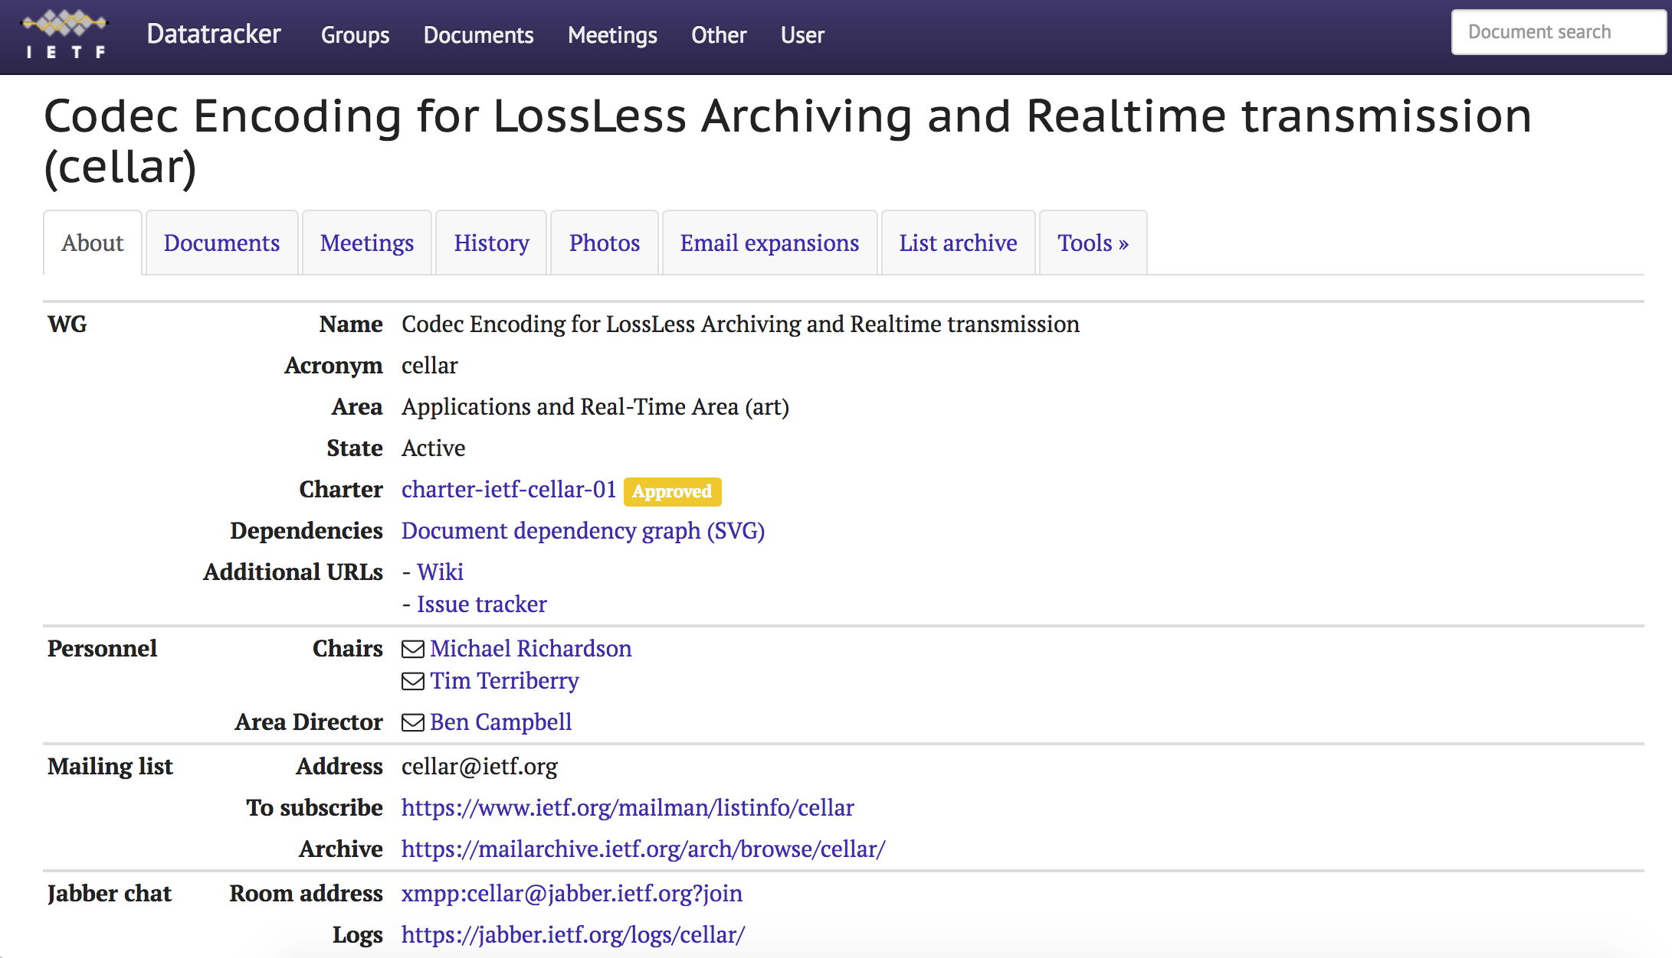
https://datatracker.ietf.org/wg/cellar

Slide 4
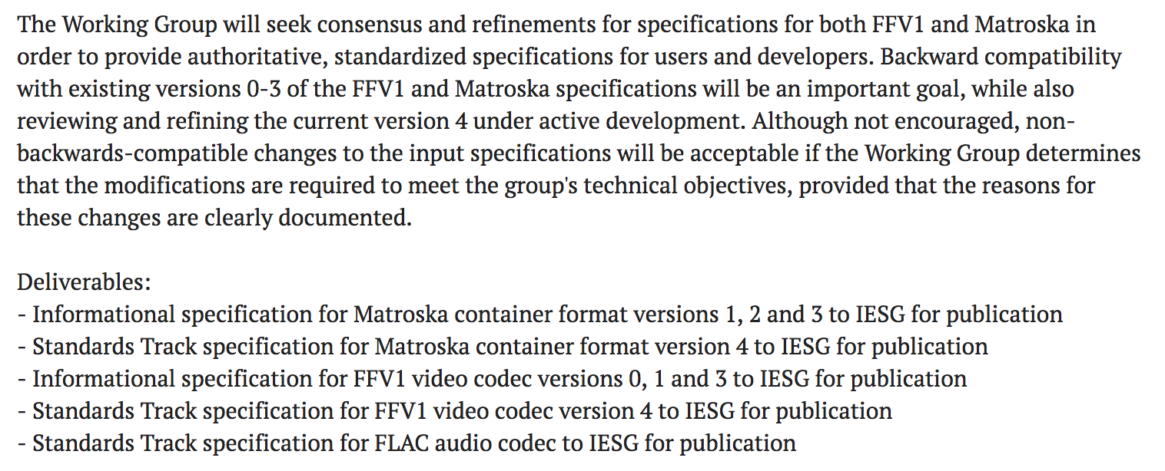

Slide 5
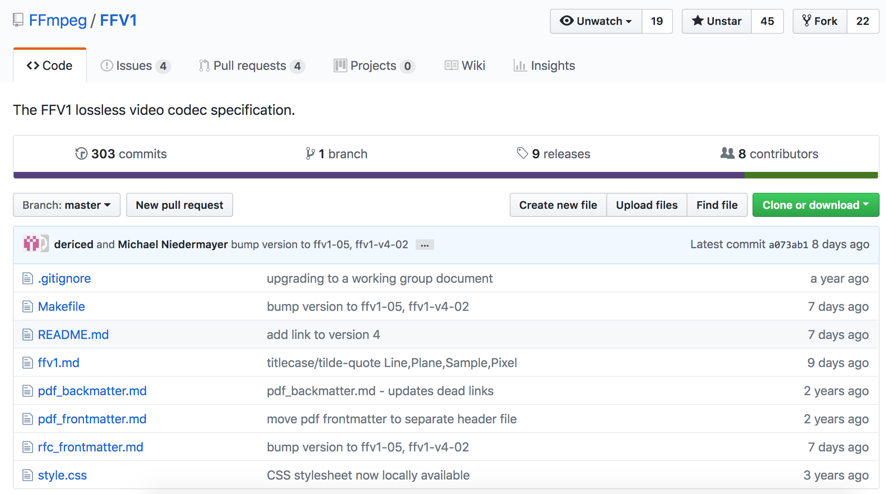
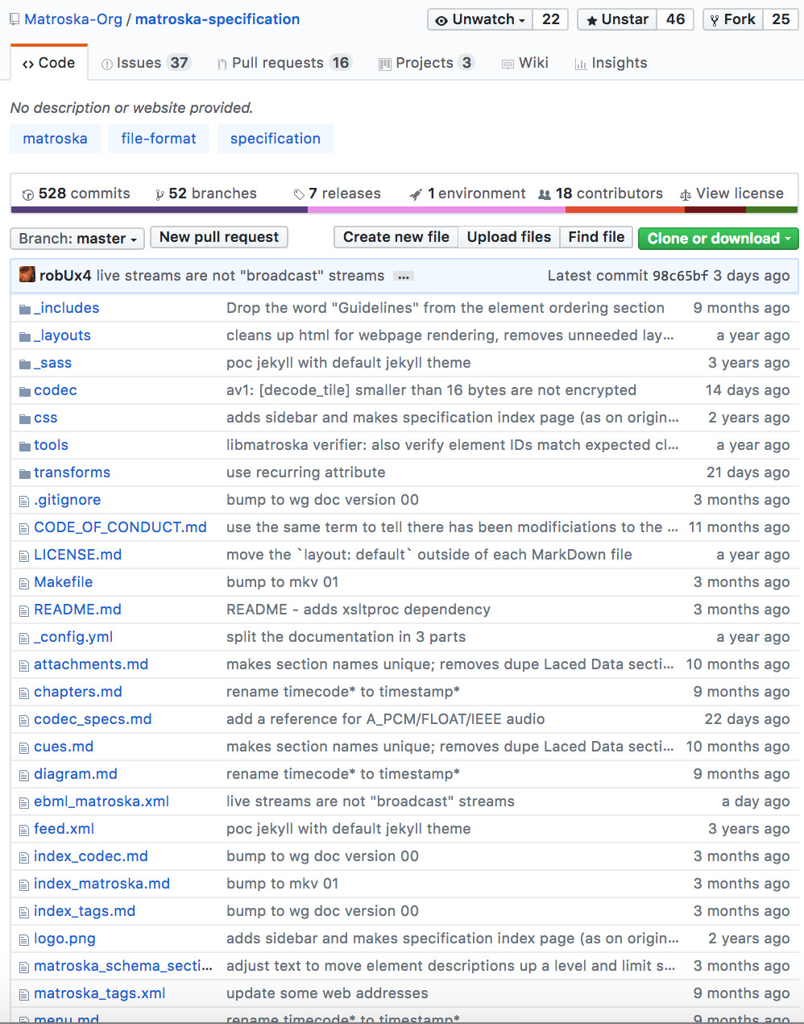
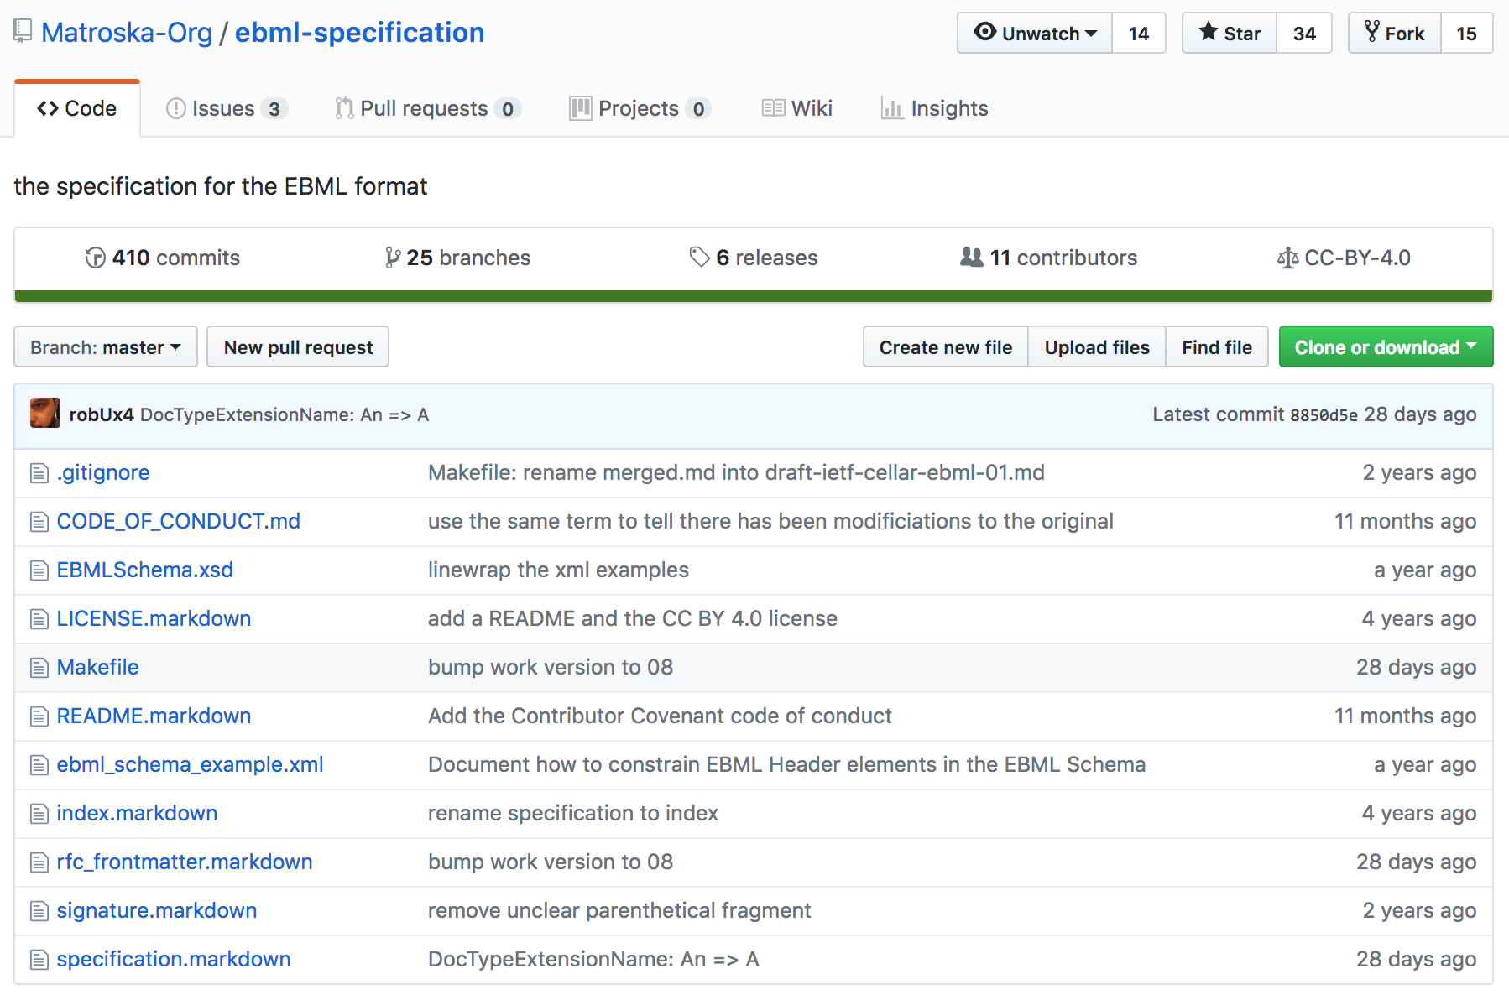

Slide 6
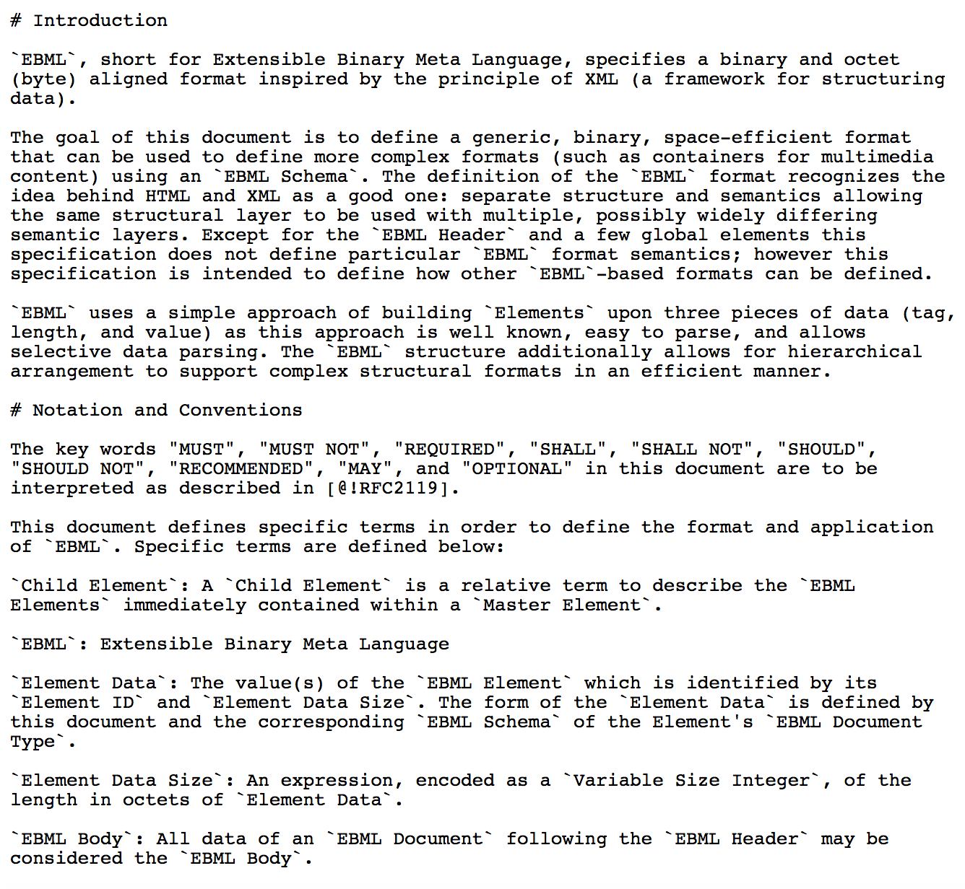
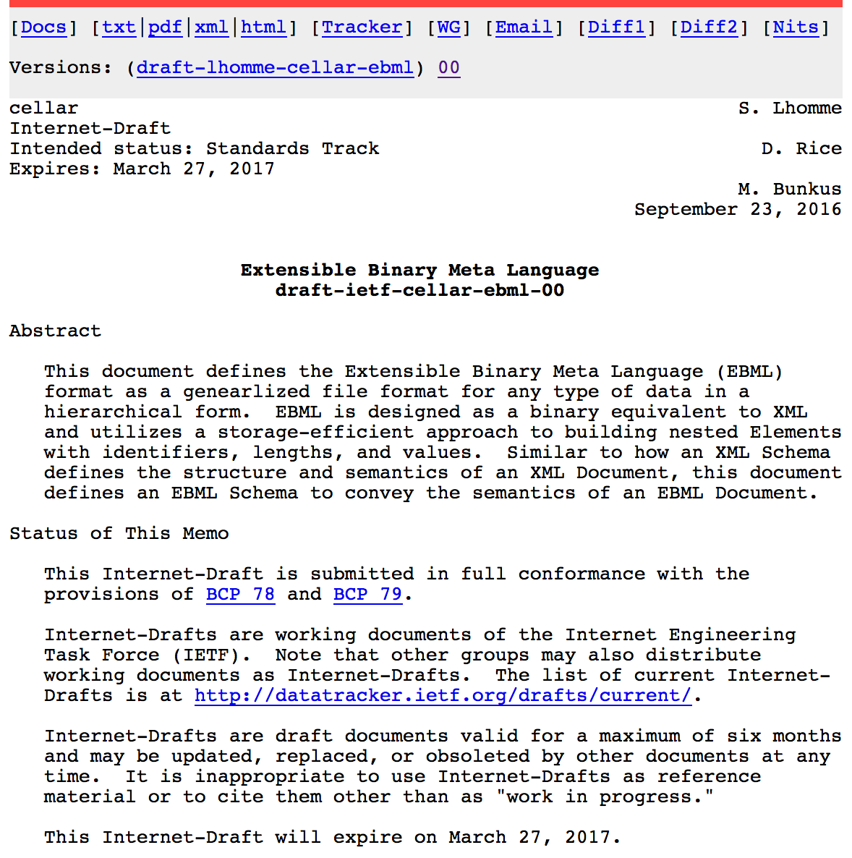
Notes:
Viola! We turn this into an RFC. RFC stands for Request for Comments, and we are actively seeking comments!

Slide 7
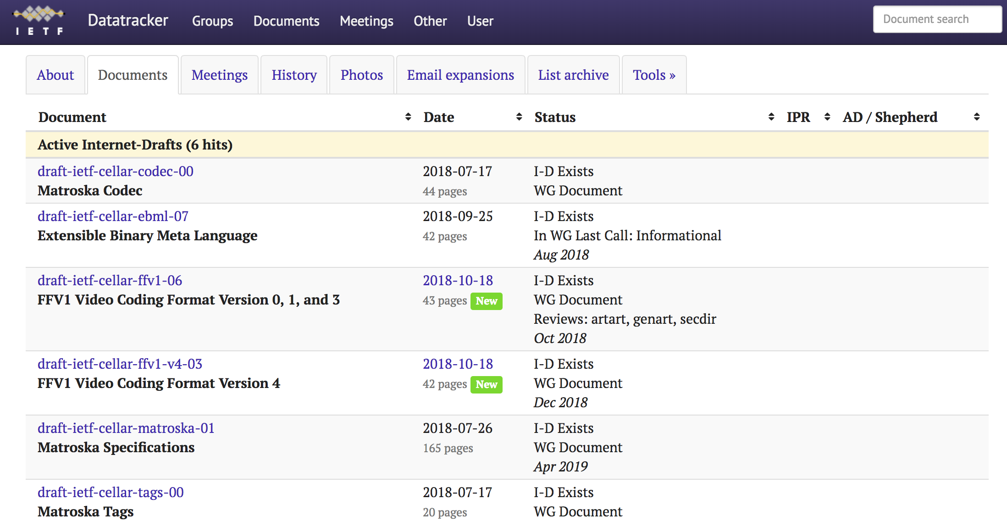
https://datatracker.ietf.org/wg/cellar/documents/

Slide 8
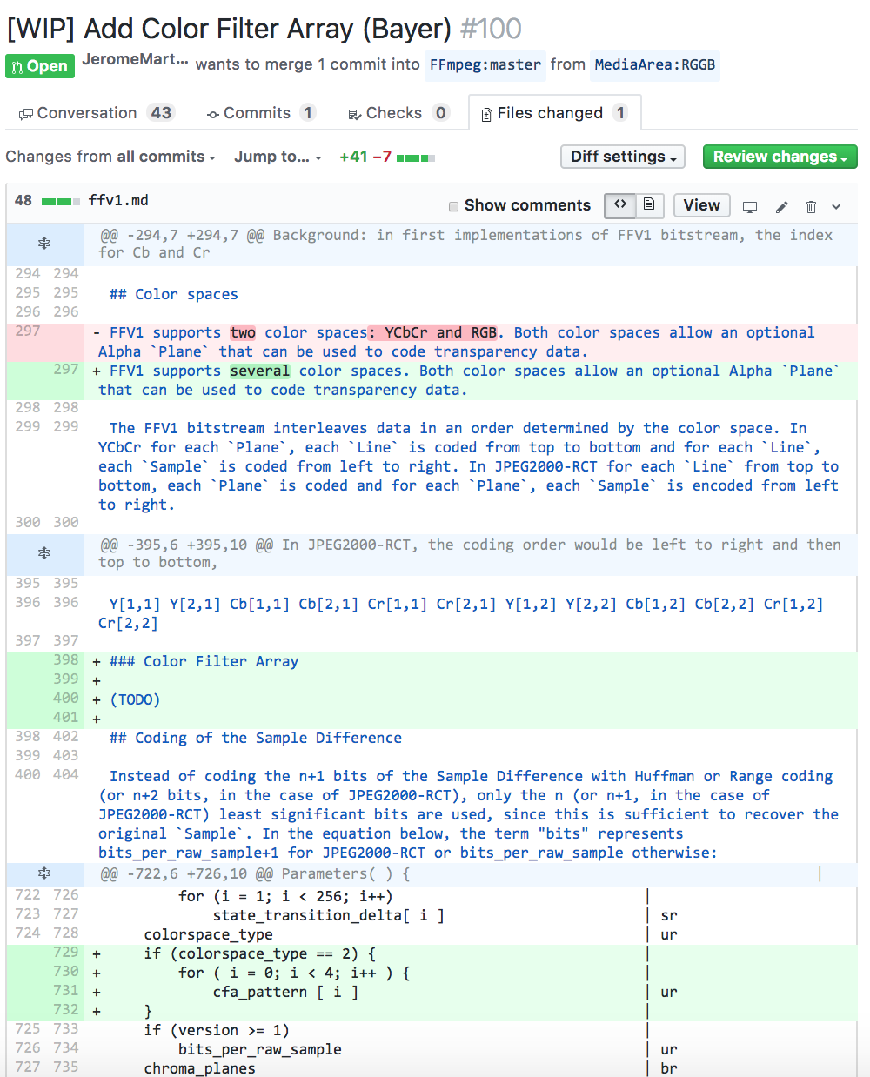
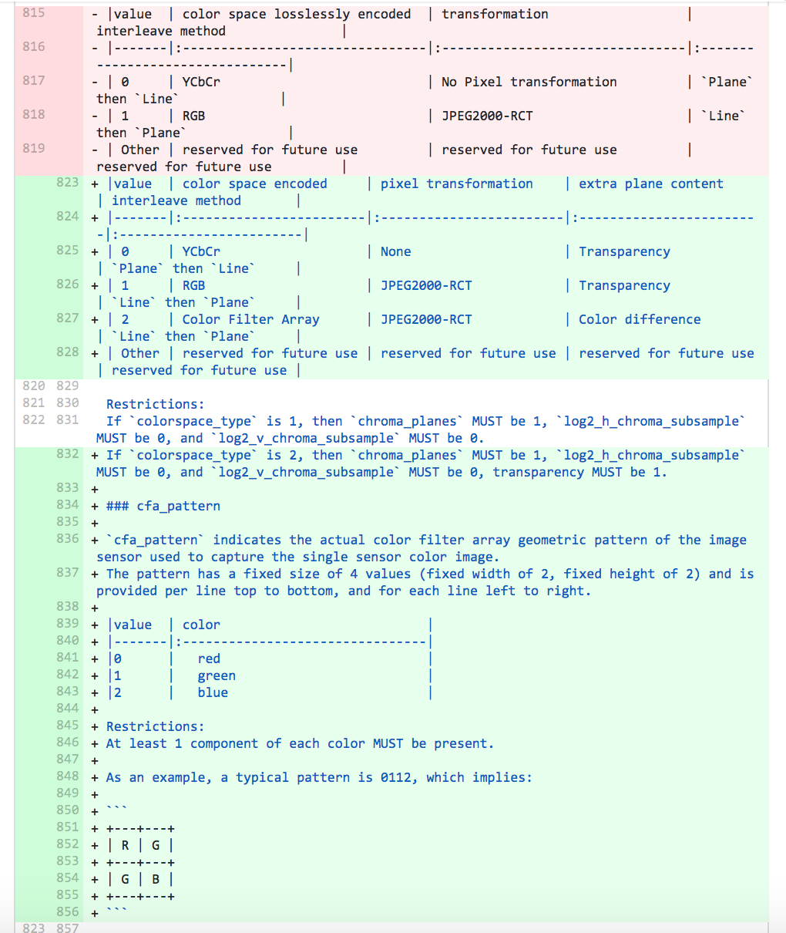

Slide 9
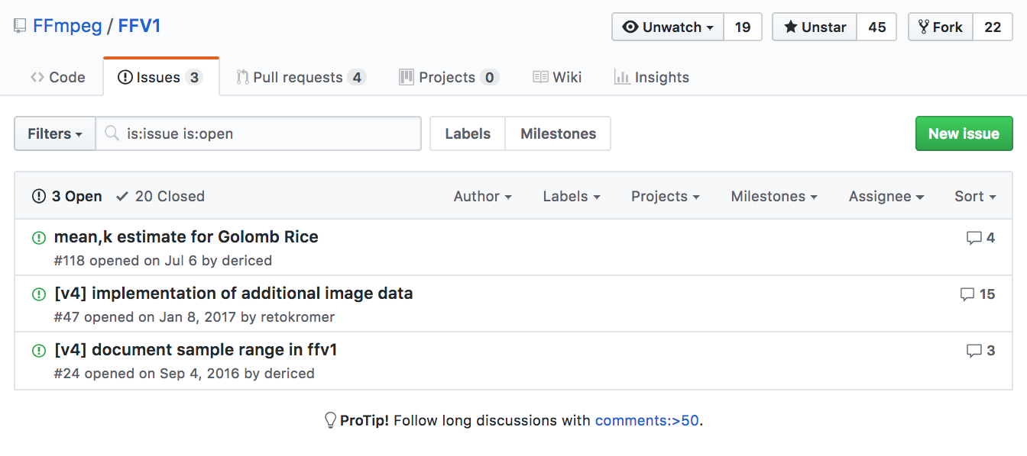
https://github.com/FFmpeg/FFV1/issues

Slide 10
https://datatracker.ietf.org/wg/cellar/documents/

Slide 11
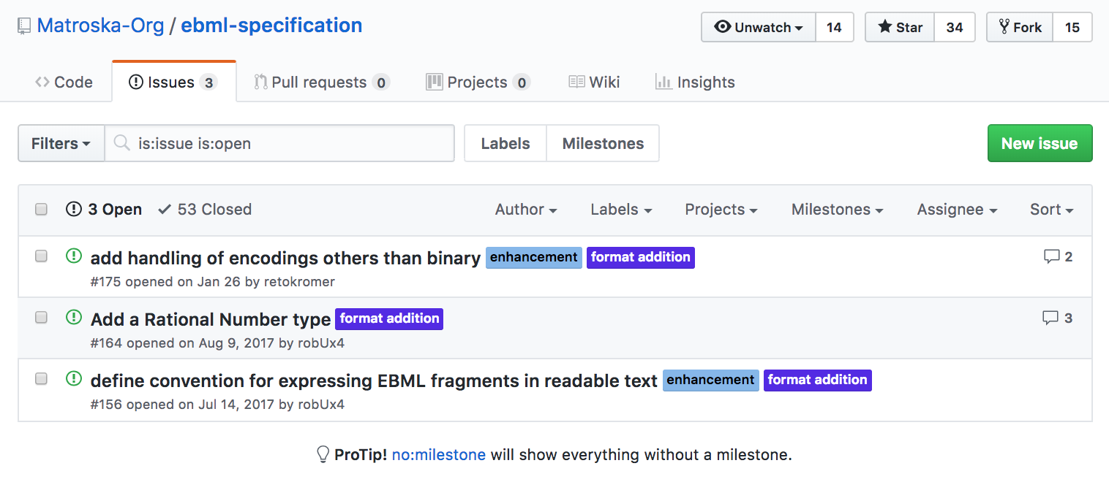
https://github.com/Matroska-Org/ebml-specification/issues

Slide 12
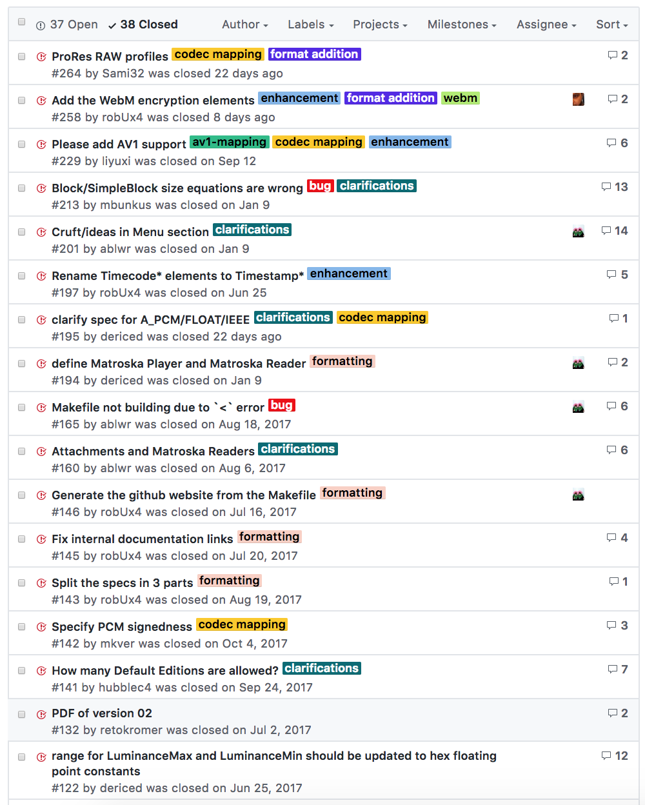
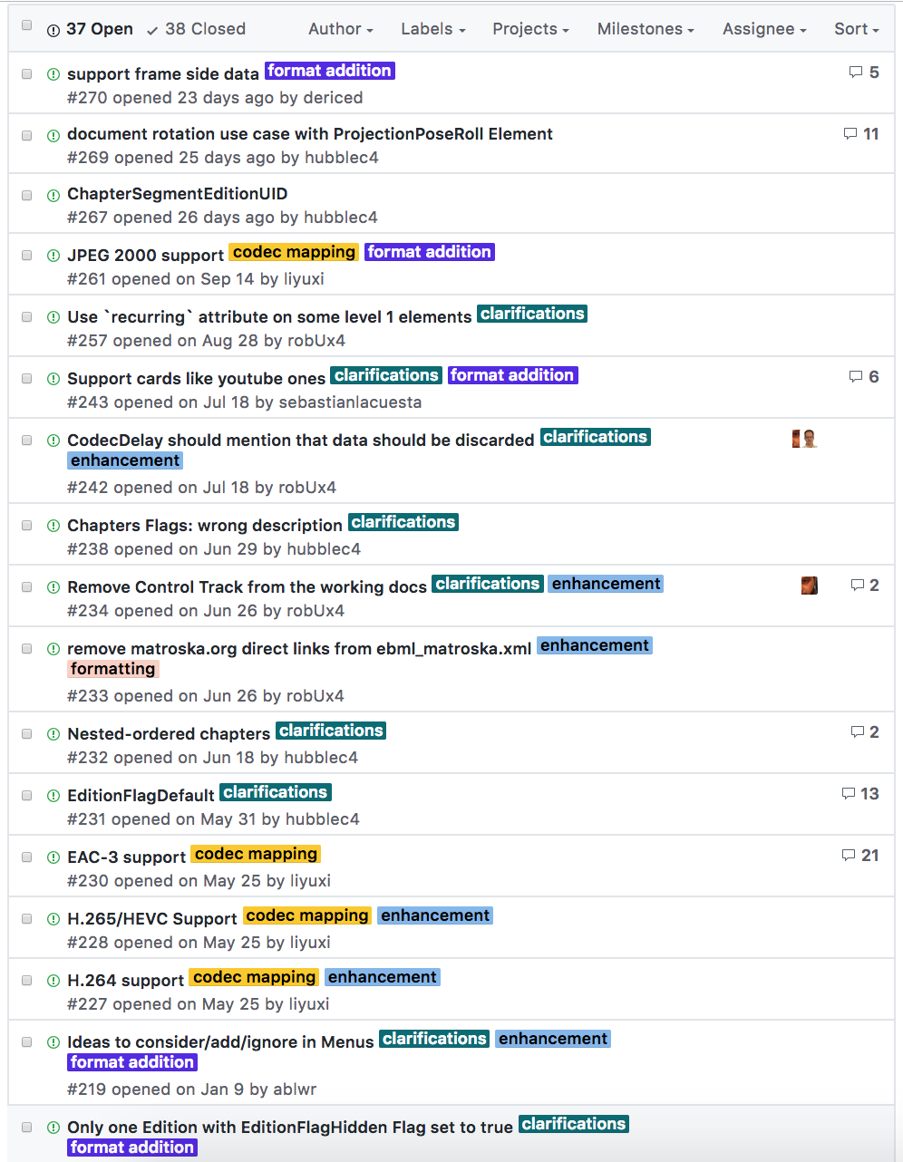
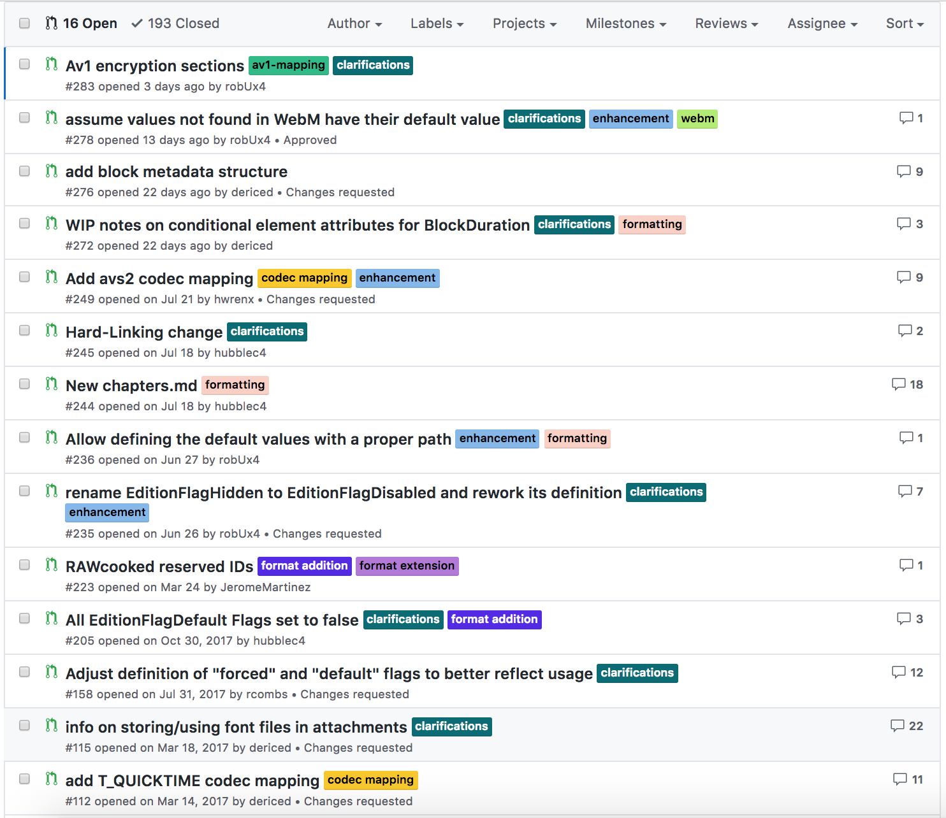

Slide 13
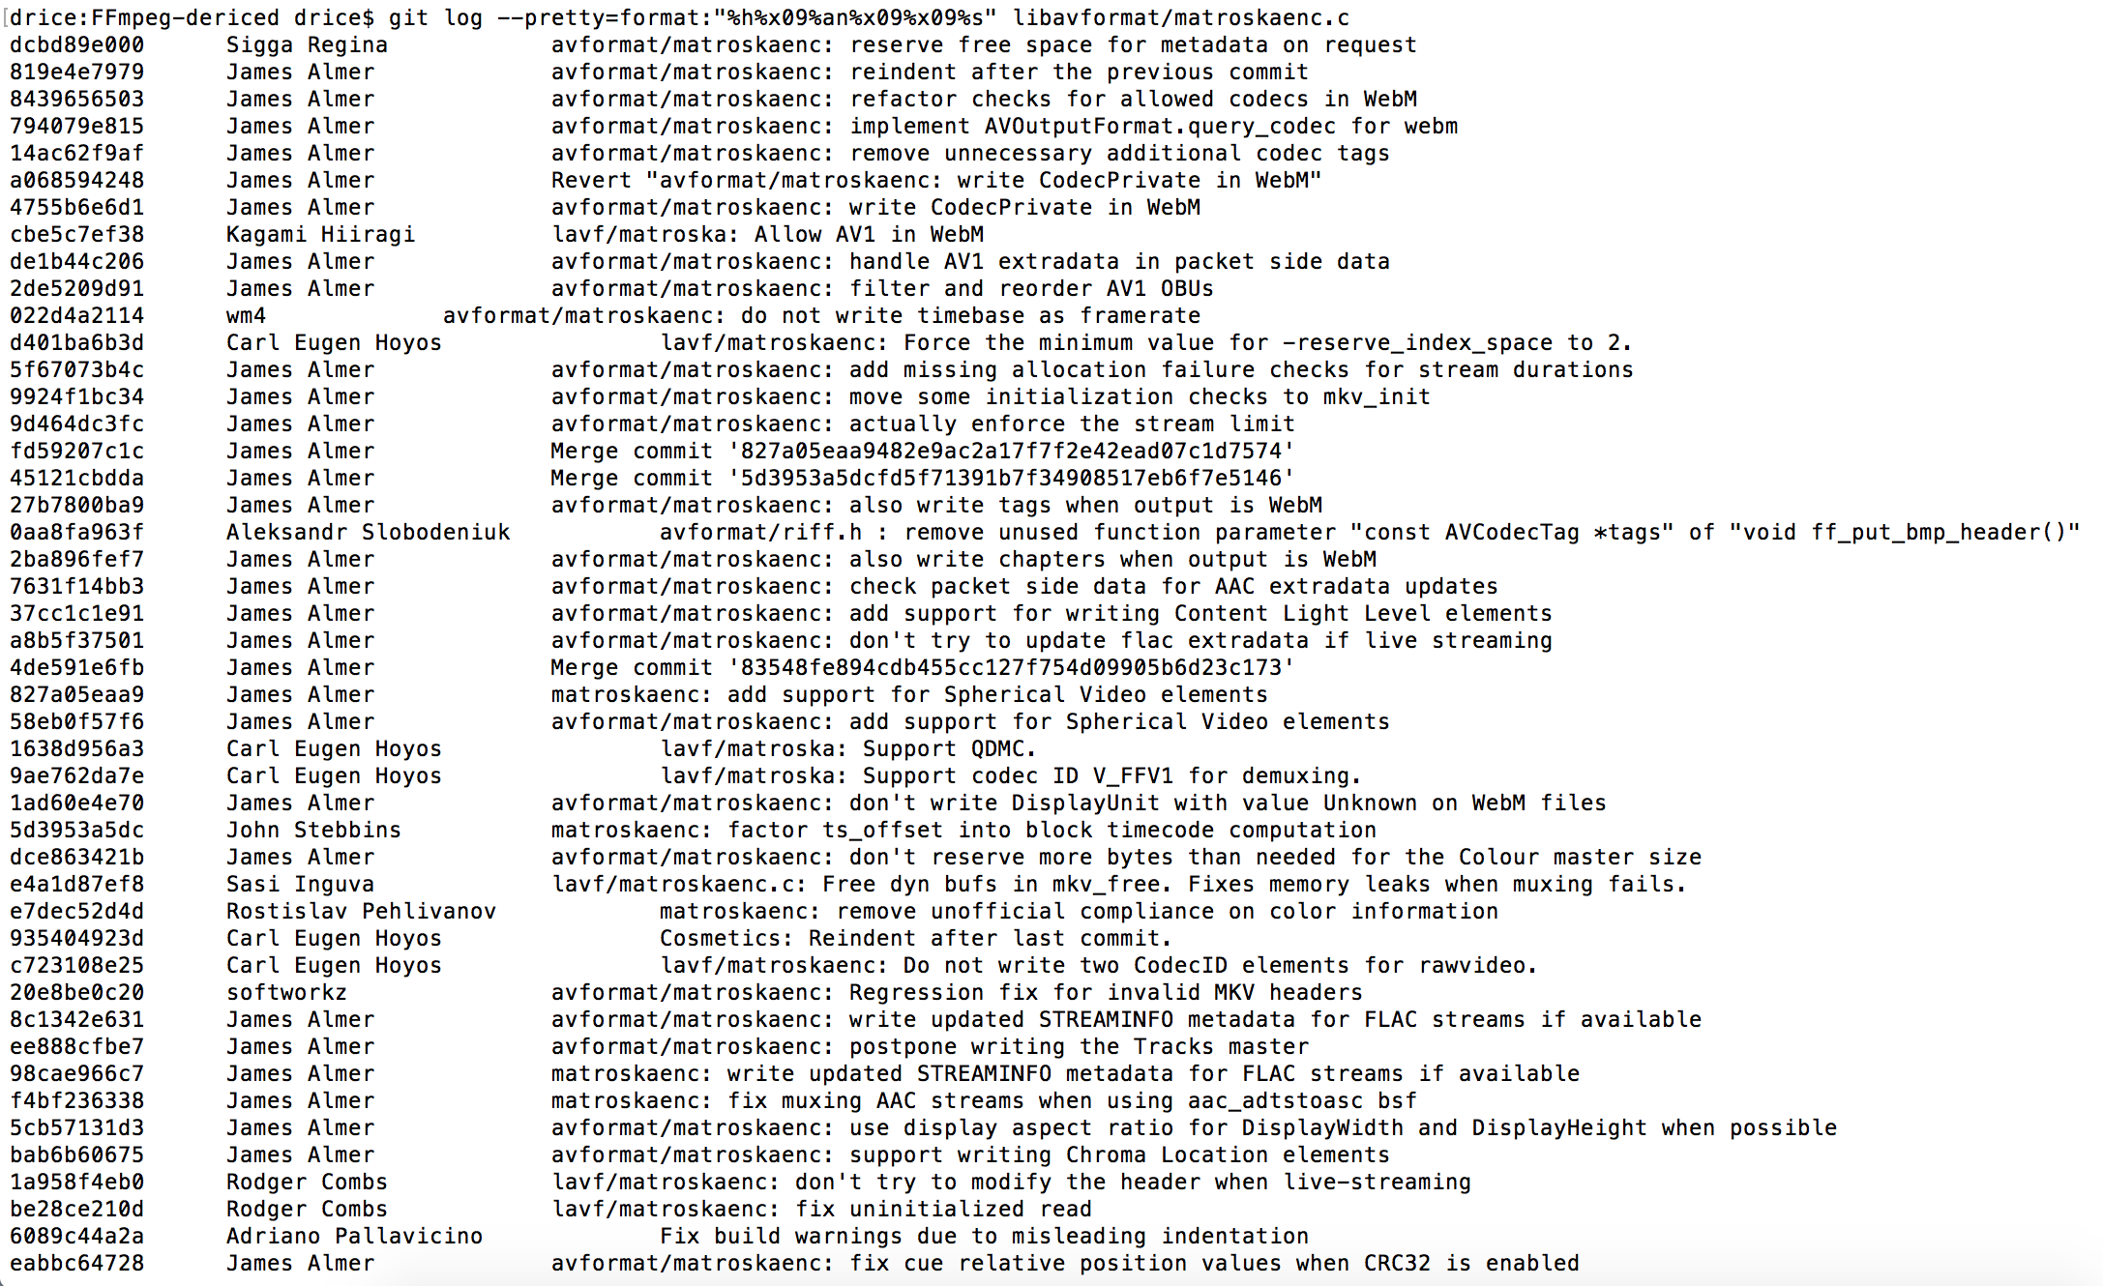

Slide 14
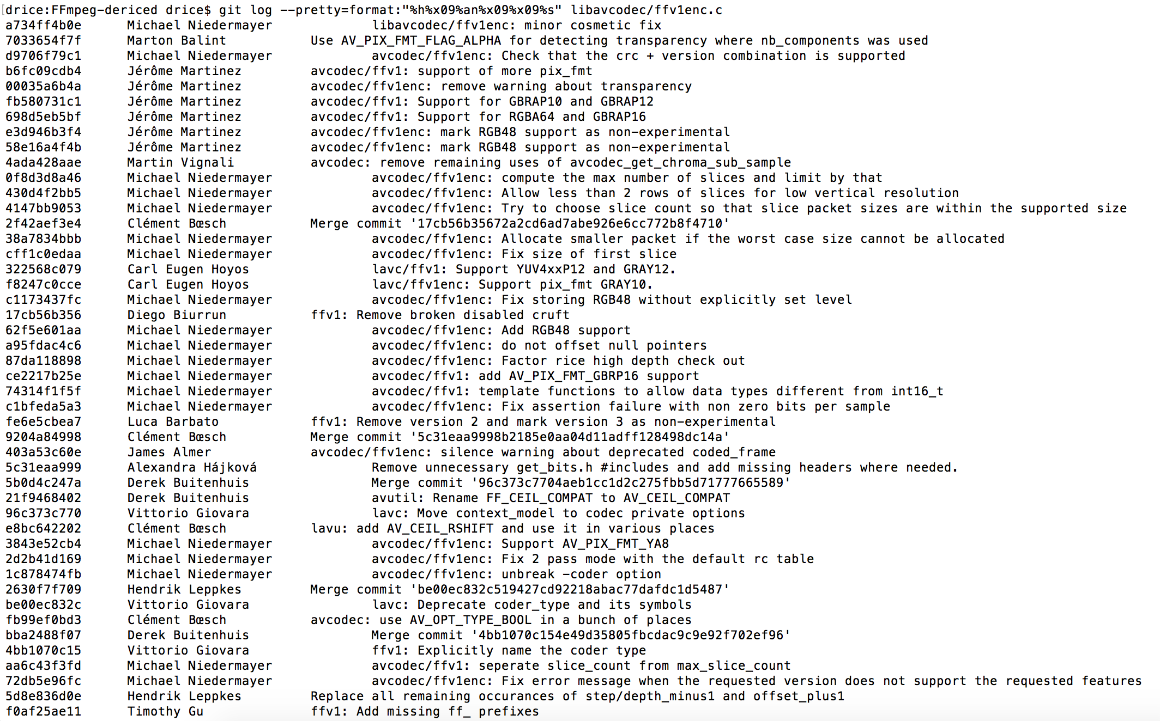

Slide 15
Thanks
https://datatracker.ietf.org/wg/cellar
https://github.com/ffmpeg/ffv1
https://github.com/Matroska-Org/matroska-specification
https://github.com/Matroska-Org/ebml-specification
@dericed 2018-10-25 #nttw3

